Slide 1
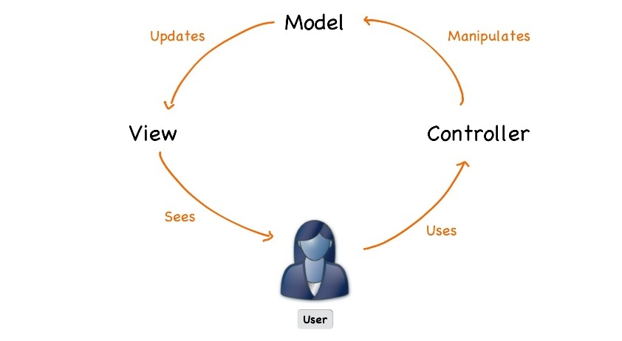



ASP.NET Core
Course Introduction
SoftUni Team
Technical Trainers
Software University
https://softuni.bg

Slide 2
Table of Contents
Course Objectives
Training and Team
Course Organization
Course Infrastructure
Evaluation Criteria
Resources

Slide 3
Questions
sli.do #csharp-web

Slide 4

Course Objectives

Slide 5
ASP.NET Core Course Content (1)
Essentials of ASP.NET Core
Razor View Engine
Application Flow, Filters and Middleware
Web API
Security and Identity
Unit Testing
Project Architecture
ML.NET

Slide 6
ASP.NET Core Course Content (2)
SignalR
Azure, Deployment and Continuous Integration
Blazor

Slide 7
Exam – Project Defense
Implementing a web application with:
.Net Core 3.1
Public defense of its work in front of a trainer
10 – 15 minutes
Demonstrate how the app works (very short)
Show the source code and explain how it works
Answer questions related to the project

Slide 8

Trainers

Slide 9
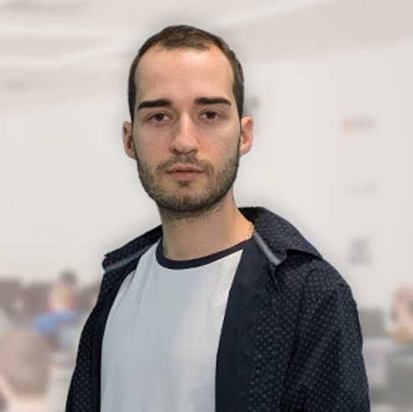
Module Team (Trainers)
Nikolay Kostov
Solutions Architect @ ZenCodeo
15+ years in the IT
Developer, Manager, Trainer, Architect
Аctive role in the development of the Judge platform - https://judge.softuni.bg/
Microsoft Certified Trainer
Personal blog: nikolay.it

Slide 10

Course Organization

Slide 11
ASP.NET Core Course at SoftUni – Timeline
18-February-2020
25-April-2020
30-April-2020
ASP.NET Core
7 weeks * 2 times / week
18 credits
Start: 18-February-2020
Project Defense: 25-April-2020
Project Defense: 30-April-2020

Slide 12

Course Workflow
Live coding
You no longer have homework
Fix bugs and implement features in the custom MVC framework
Work with github
Groups of lectures are followed by workshops
Knowledge is used to extend an application
Best practices are applied

Slide 13



Scoring System for the Course
Theoretical Exam 5%
Presence in class 5%
Project 95%
Evaluation

Slide 14



Course Web Site, Forum and FB Group
Official web site:
Official discussion forum:
Official Facebook groups:
https://softuni.bg/trainings/2613/csharp-web-basics-january-2020
https://softuni.bg/forum/categories/66/csharp-web-development-basics
https://www.facebook.com/groups/CSharpWebJanuary2020/

Slide 15

What Do We Need Additionally?
Resources

Slide 16


Required Software
Software needed for this course:
Microsoft Windows (Win 10 / 8.1 / Win8 / Win7) or Mac or Linux
Visual Studio 2019

Slide 17
Learn to Search in Internet & Find Solutions
The course assignments require to search in Internet
This is an important part of the learning process
Some exercises intentionally have no hints
Learn to find solutions!
Software development includes everyday searching and learning!
No excuses, just learn to study!
Developers learn new technologies, tools, languages every day!

Slide 18
Questions?
Notes:
18

Slide 19












SoftUni Diamond Partners

Slide 20




SoftUni Organizational Partners

Slide 21
Trainings @ Software University (SoftUni)
Software University – High-Quality Education, Profession and Job for Software Developers
softuni.bg, softuni.org
Software University Foundation
softuni.foundation
Software University @ Facebook
facebook.com/SoftwareUniversity
Software University Forums
forum.softuni.bg
Notes:
21

Slide 22

License
This course (slides, examples, demos, exercises, homework, documents, videos and other assets) is copyrighted content
Unauthorized copy, reproduction or use is illegal
© SoftUni – https://softuni.org
© Software University – https://softuni.bg
Notes:
22

